Slide 1





Northwind
Traders
Perf’Dashboard
SALES
CUSTOMERS
ORDERS
DELIVERY
Made by Patrice Fayard

Slide 2


Northwind
Traders
Perf’Dashboard
SALES
FORECAST
DISCOUNT
DELIVERY
Made by Patrice Fayard

Slide 3
Northwind
Traders
Perf’Dashboard
SALES
CUSTOMERS
ORDERS
Made by Patrice Fayard

Slide 4



Northwind
Traders
Perf’Dashboard
SALES
BASKET
PRODUCTS
ORDERS
Made by Patrice Fayard

Slide 5
Northwind
Traders
Perf’Dashboard
SALES
ORDERS
Made by Patrice Fayard

Slide 6
Northwind
Traders
Perf’Dashboard
SHIPPING COST
ORDER
Made by Patrice Fayard

Slide 7
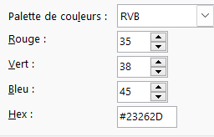



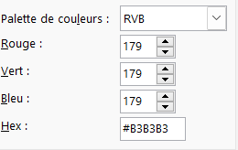
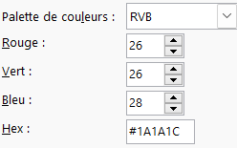
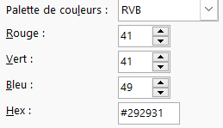
Northwind
Traders
SALES
CUSTOMER
PRODUCT
EMPLOYEES

Slide 8
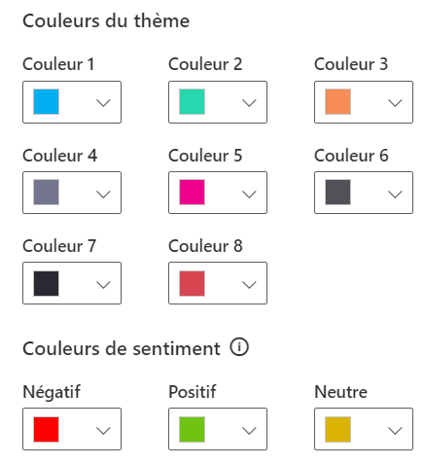
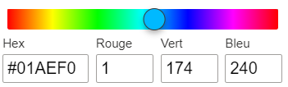
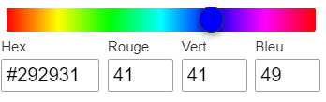

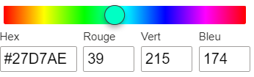
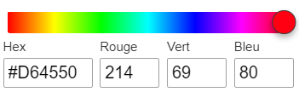

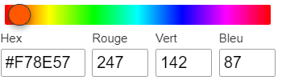

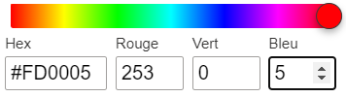

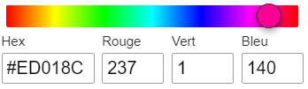
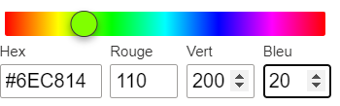

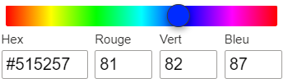
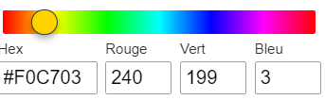

Slide 9

Northwind
Traders
Perf’Dashboard
SALES
CUSTOMERS
ORDERS
SHIPPERS
Made by Patrice Fayard

Slide 10












Northwind
Traders
Northwind
Traders
Northwind
Traders
Northwind
Traders

Slide 11
Northwind
Traders
Perf’Dashboard
SALES
CUSTOMERS
ORDERS
DELIVERY
Made by Patrice Fayard

